Slide 1
Association Rule MIning
by Joshi, Akhilesh Diliprao

Slide 2
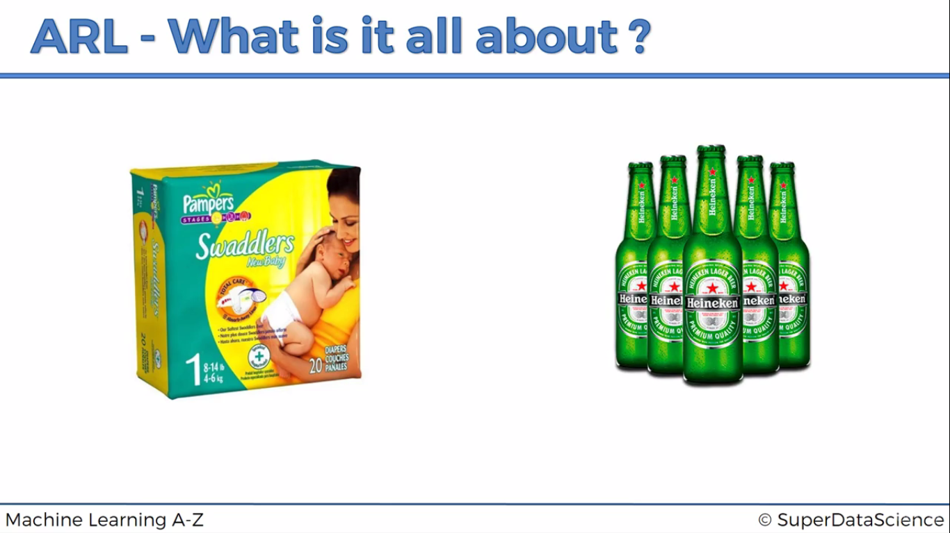

Slide 3
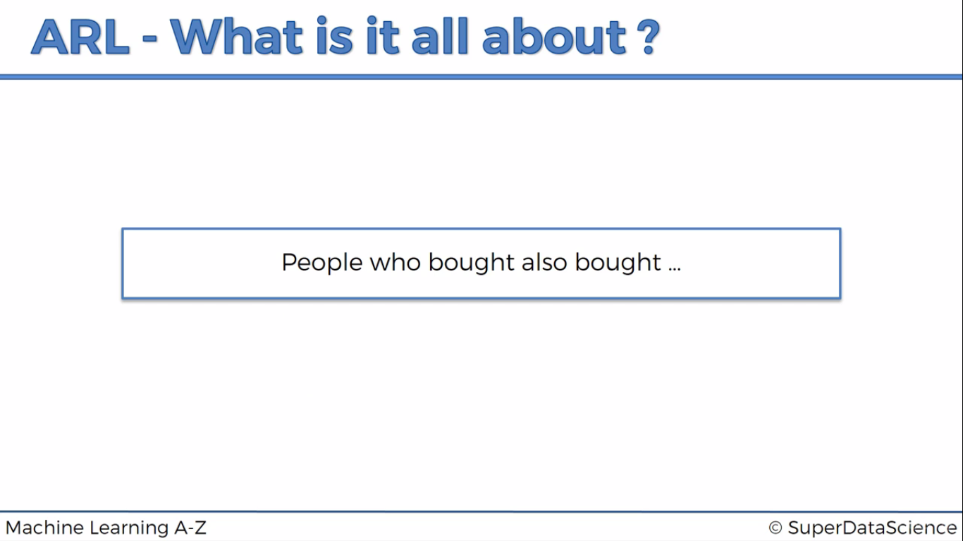

Slide 4
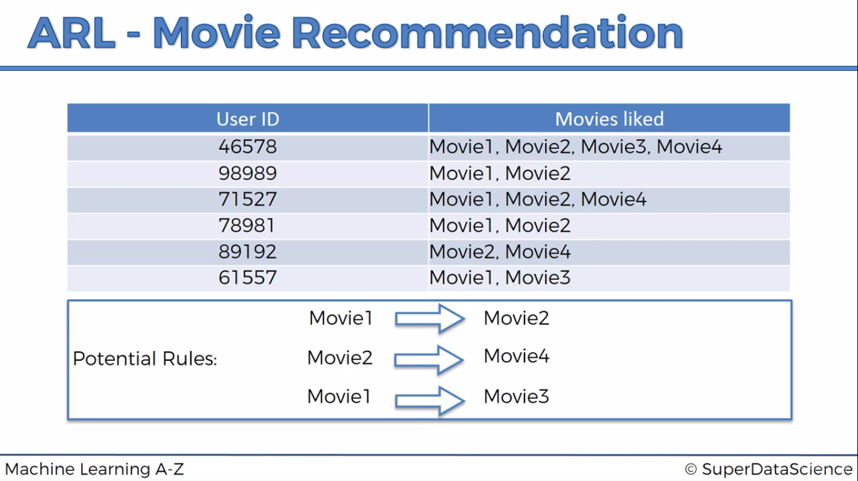

Slide 5
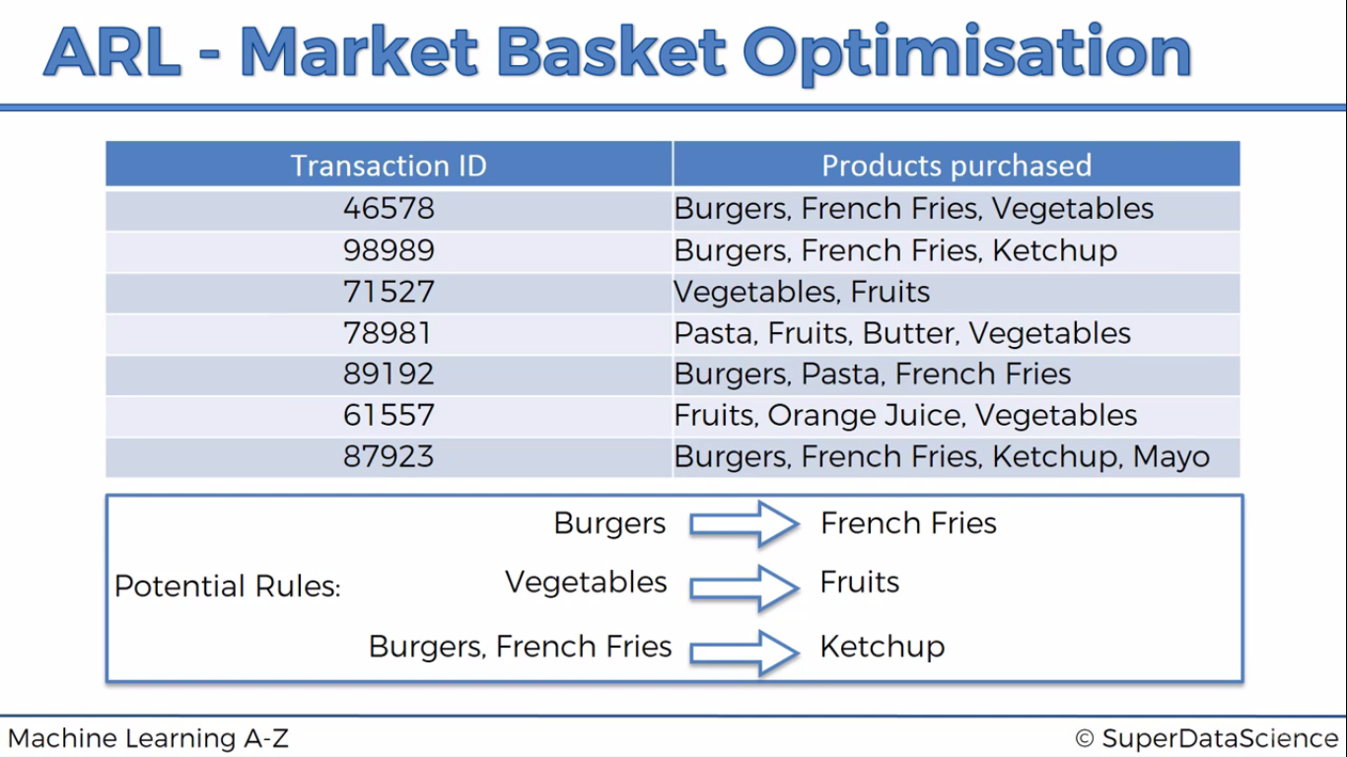

Slide 6
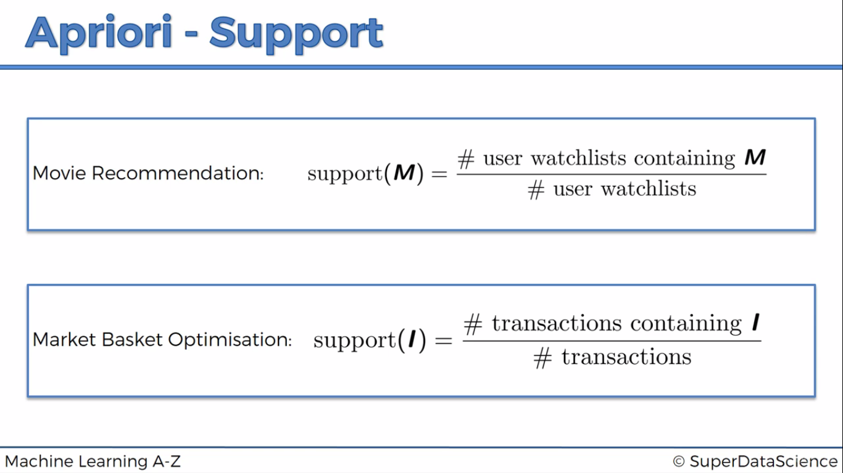

Slide 7
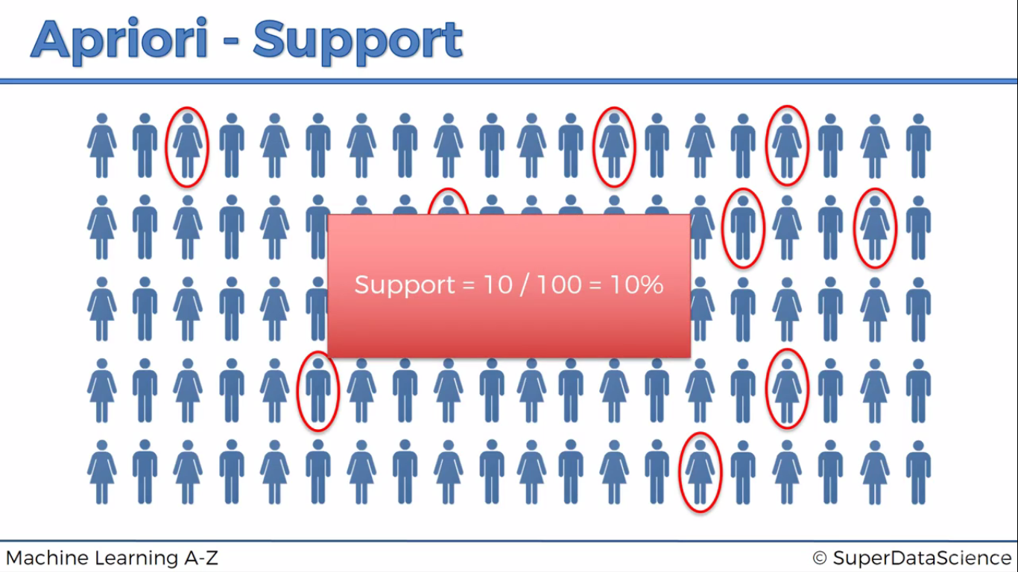

Slide 8
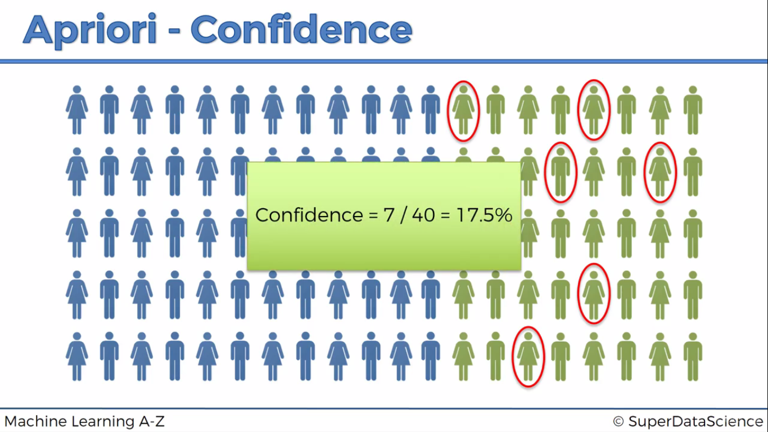

Slide 9
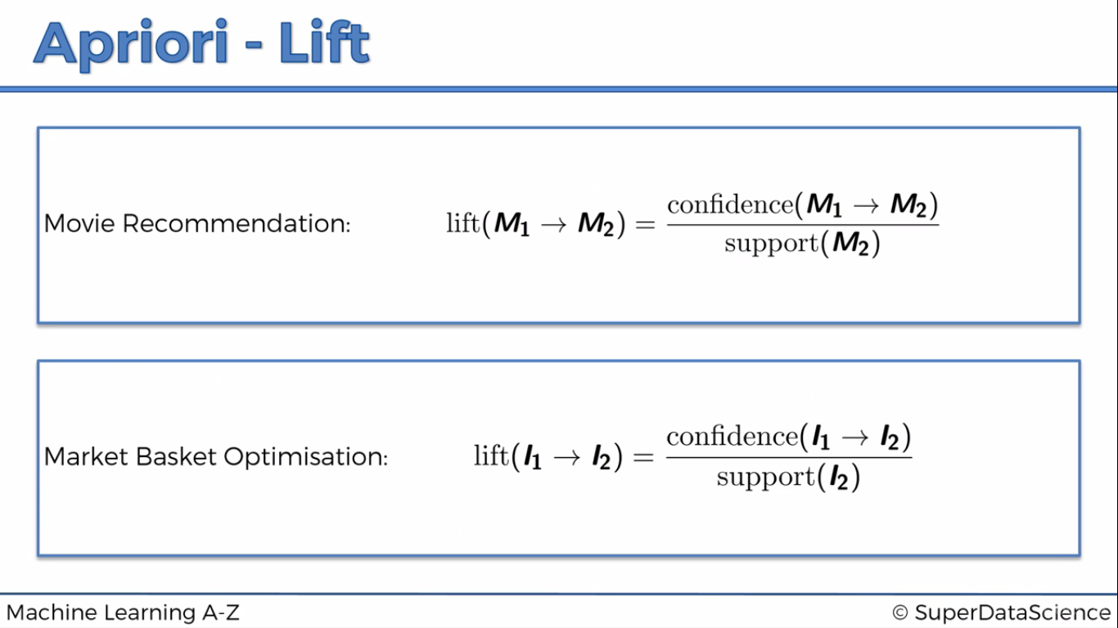

Slide 10
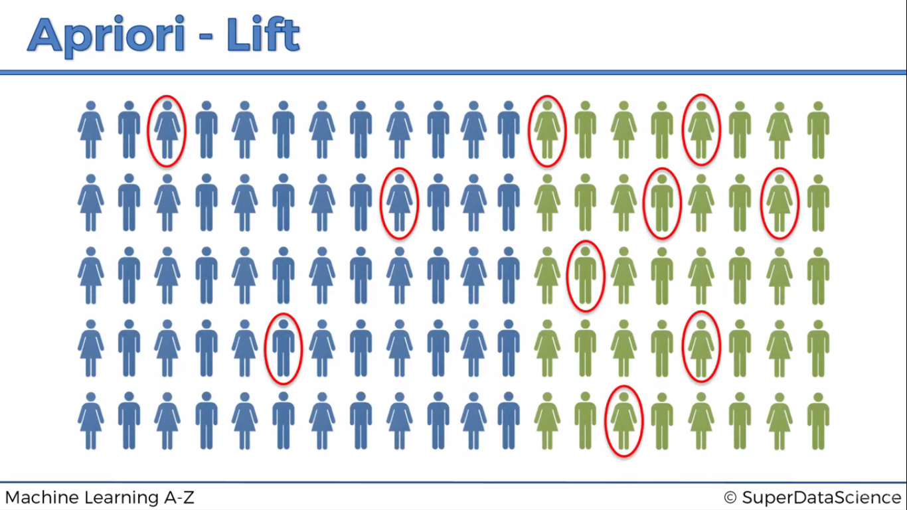

Slide 11
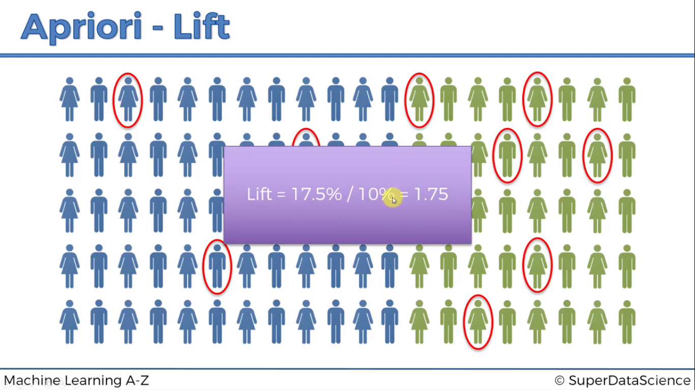

Slide 12
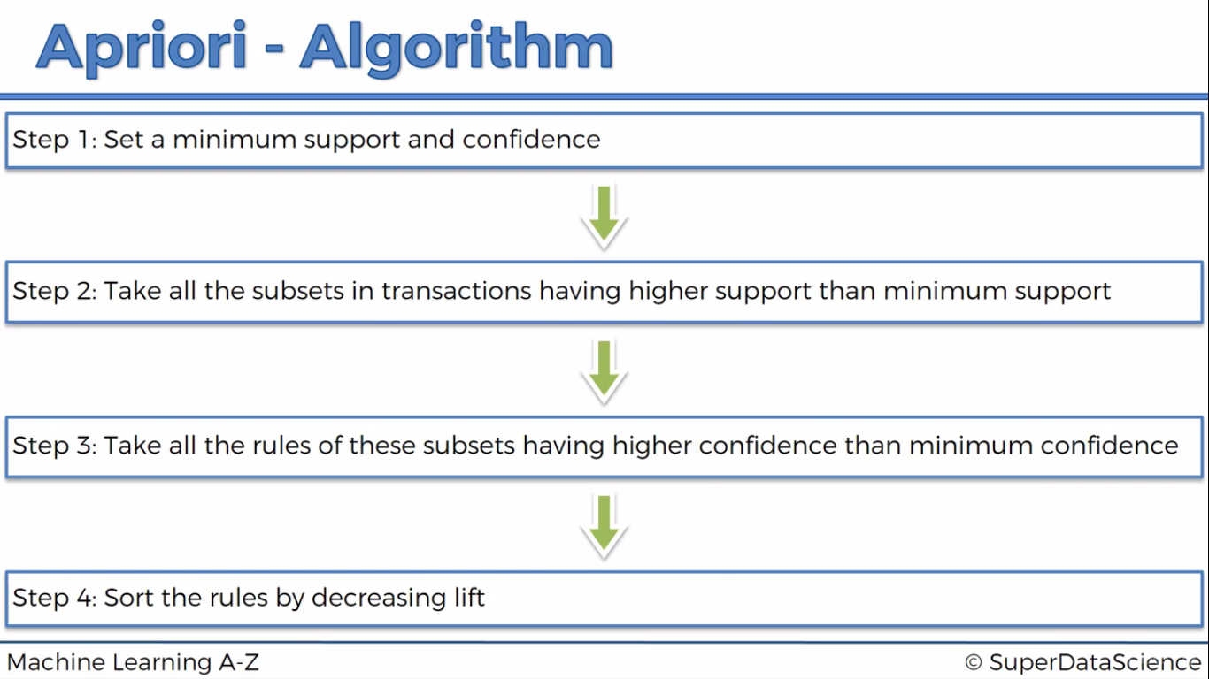

Slide 13

Python

Slide 14
Importing the libraries
import numpy as np
import matplotlib.pyplot as plt
import pandas as pd

Slide 15
Importing dataset
dataset = pd.read_csv("D:/machine learning AZ/Machine Learning A-Z Template Folder/Part 5 - Association Rule Learning/Section 28 - Apriori/Apriori_Python/Market_Basket_Optimisation.csv", header = None)

Slide 16
Create list of list for apriori algorithm
transactions = []
for item in dataset.values:
temp = [str(i) for i in item.tolist()]
transactions.append(temp)

Slide 17
Apriori details
#https://pypi.python.org/pypi/apyori/1.0.0
#http://franklinwillemen.com/machine-learning/association-rule-learning.html

Slide 18
Training Apriori on the dataset
from apyori import apriori
rules = apriori(transactions, min_support = 0.003, min_confidence = 0.2, min_lift = 3, min_length = 2)
#min_length : atleast compare two items ; if we keep it 1 then it makes no sense
#min_support : based on domain knowledge (here products that are purchased daily 3*7/7500)

Slide 19
Results
results= list(rules)
myResults = [list(x) for x in results]

Slide 20

R

Slide 21
Libraries
library(readr)
library(arules)

Slide 22
dataset
dataset <- read_csv("D:/machine learning AZ/Machine Learning A-Z Template Folder/Part 5 - Association Rule Learning/Section 28 - Apriori/Apriori_Python/Market_Basket_Optimisation.csv",col_names = FALSE)
dataset1 = read.transactions('D:/machine learning AZ/Machine Learning A-Z Template Folder/Part 5 - Association Rule Learning/Section 28 - Apriori/Apriori_Python/Market_Basket_Optimisation.csv', sep = ',', rm.duplicates = TRUE)

Slide 23
# Training Apriori on the dataset
rules = apriori(data = dataset1, parameter = list(support = 0.004, confidence = 0.2))

Slide 24
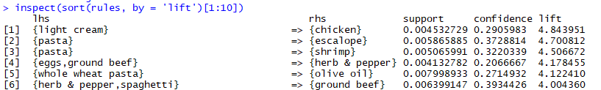
Visualising the results
inspect(sort(rules, by = 'lift')[1:10])

